Slide 1
SABR and BiSABR
Date : January 18th 2007
Rédacteur : Olivier Croissant
IXIS Corporate & Investment Bank

Slide 2
Why do we need a SABR Model?
We need to represent Smiles (cap/swaption/CMS swaptions)
    Parameter acting on the general level of the volatility : alpha
    Parameters acting on the smile slope : beta, rho.
    Parameters acting on the convexity of the smile : nu
    Euro markets : beta ~ 0.5-0.7
    Yen : beta ~ 0.5
    Calibrating the smile ⬄ determining (alpha, rho, nu)
The SABR Model has an European option Formula (Hagan approximation)

Slide 3
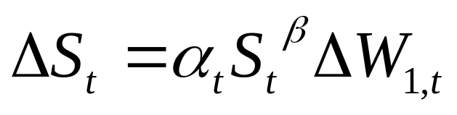
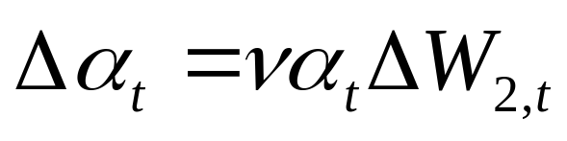
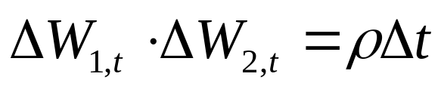
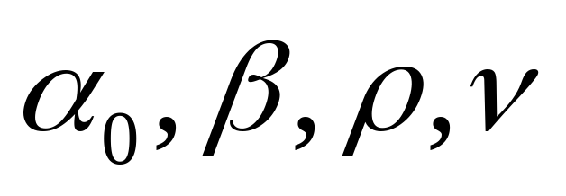
SABR : Equations
Equations
Parameters

Slide 4
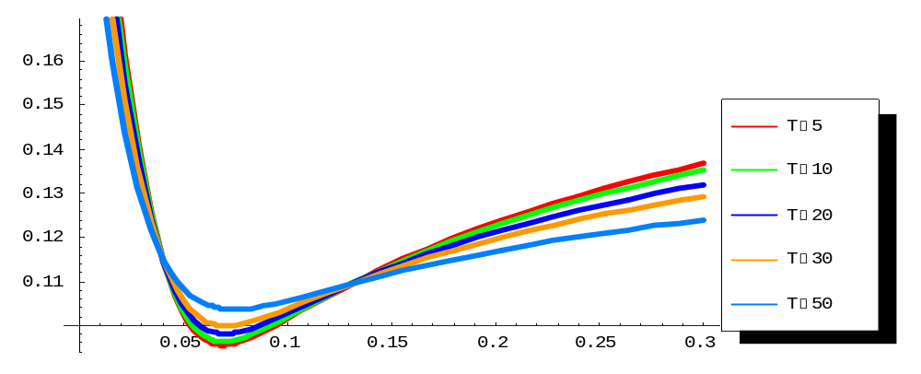
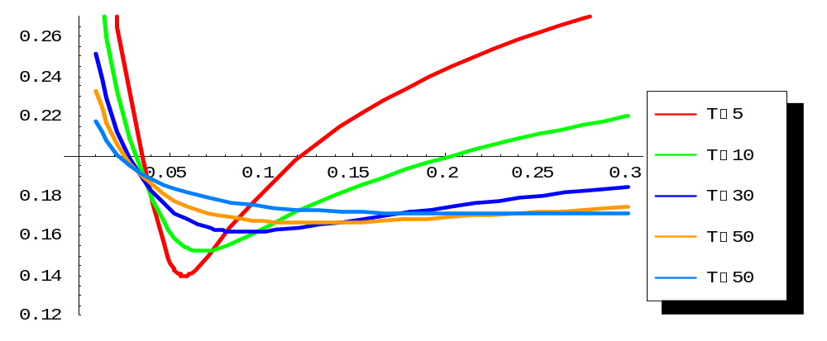
Stochastic Volatility Models
Volatility surfaces for SABR
Compared with a Heston model
SABR smile persists longer
Than Heston SABR
Easier to control

Slide 5
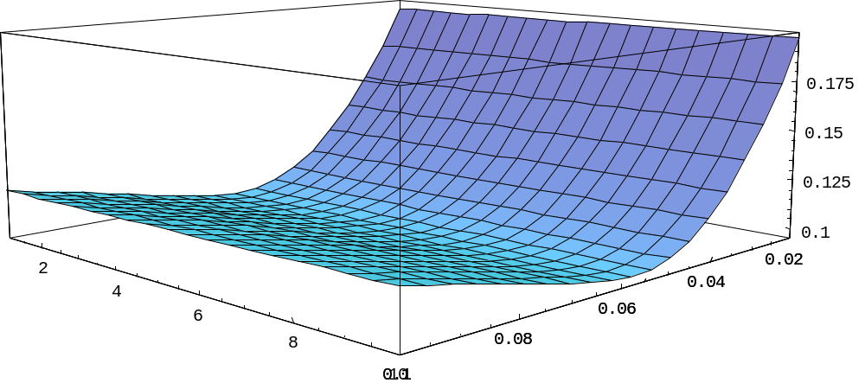
SABR Vol surface
vol
T
K
The short term smile is not captured by the hagan formula

Slide 6
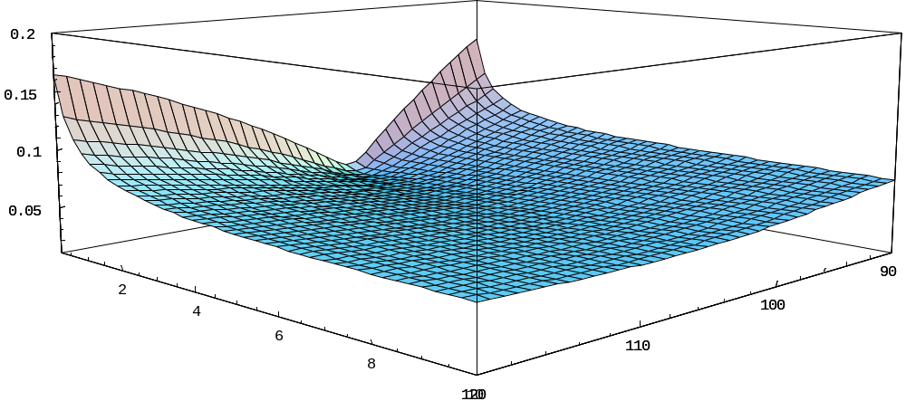
Heston Vol Surface
Vol
K
T

Slide 7
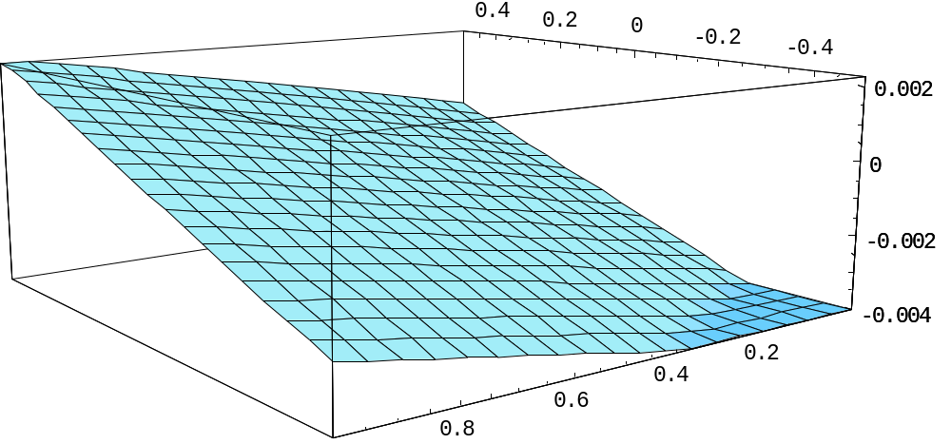
Beta , Rho & Smile Slope
Smile Slope
Rho (correlation)
Beta (local vol)
So low beta ⬄ low rho

Slide 8
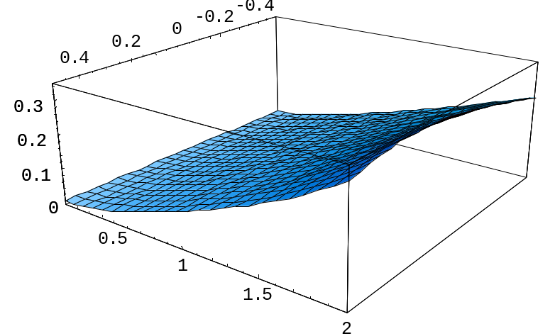
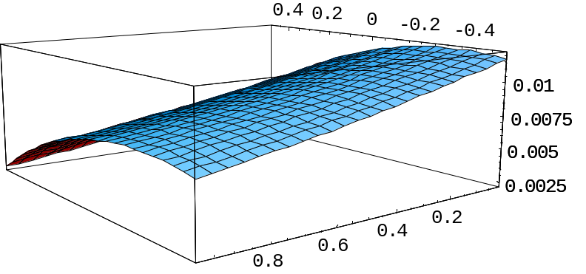
The convexity is given by nu (vol - vol)
Smile Convexity
Rho (corr.)
Beta (local vol)
Rho (corr.)
Nu (vol of vol)

Slide 9
Change of PL due to Recalibration
In general
 | In The Money | Out Of The Money
Rho ↑ | Price ↓ | Price ↑
Nu ↑ | Price ↑

Slide 10
Why do we need BiSABR
We need to represent spreadoption prices, Given the smiles of the underlyings
Notion of implied normal correlation: given a spreadoption implied normal volatility => Correlation smile
The BiSABR Formula is similar to the Hagan formula for Vanilla options.
4 correlations to represent the correlation smile
  one correlation between underlyings
  two cross-correlations
  one correlation between volatilities

Slide 11
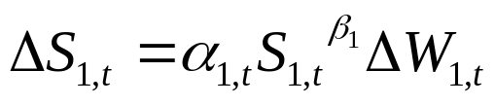
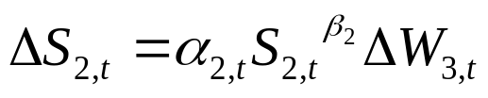
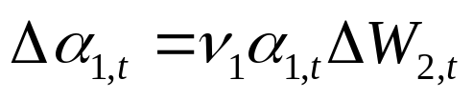
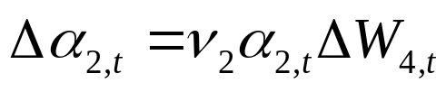
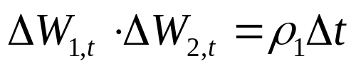





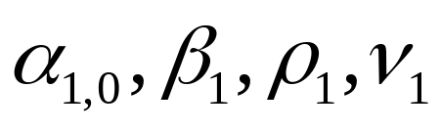
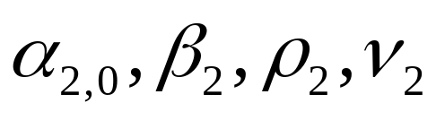
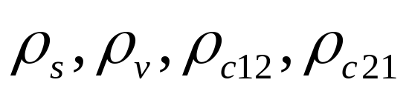
BiSABR : Equations
Index 1
Index 2
Correlations
Parameters

Slide 12
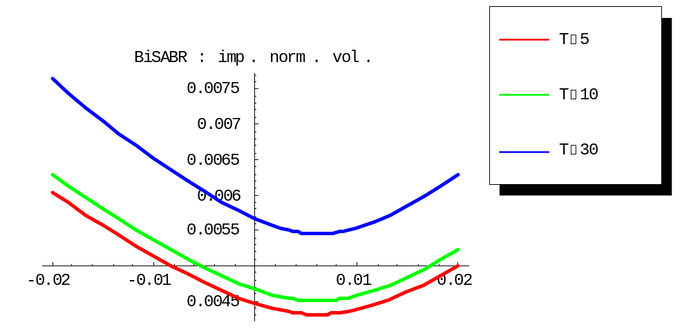
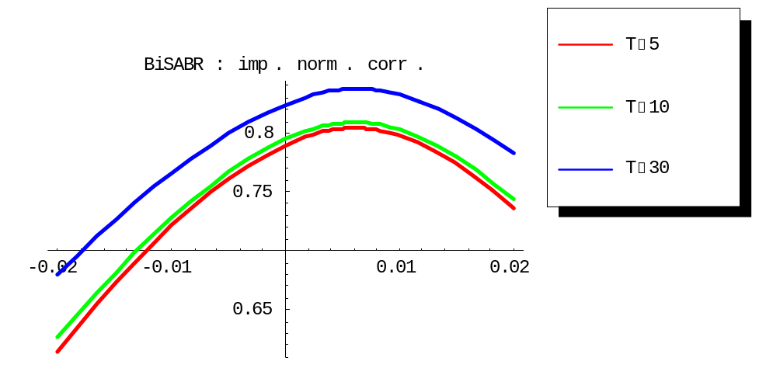
BiSABR for the Correlation Smile
A natural effect : rise of the implied correlation with maturity

Slide 13
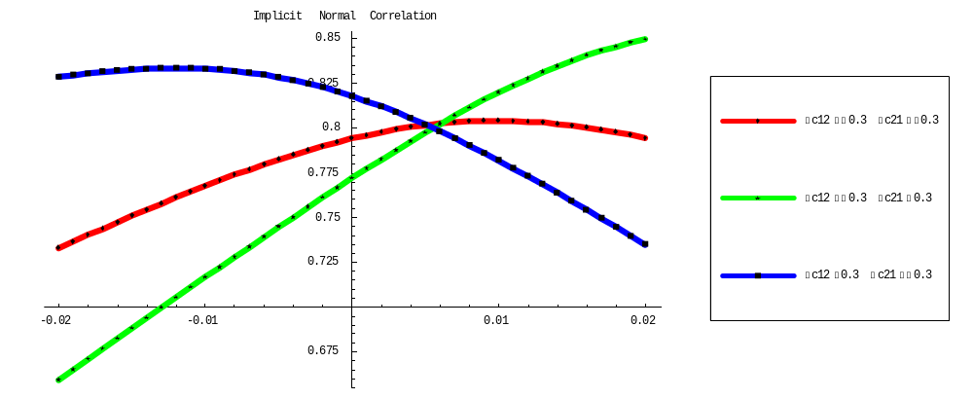
BiSABR : Cross Correlations
Calibrating the Correlation Smile Slope

Slide 14
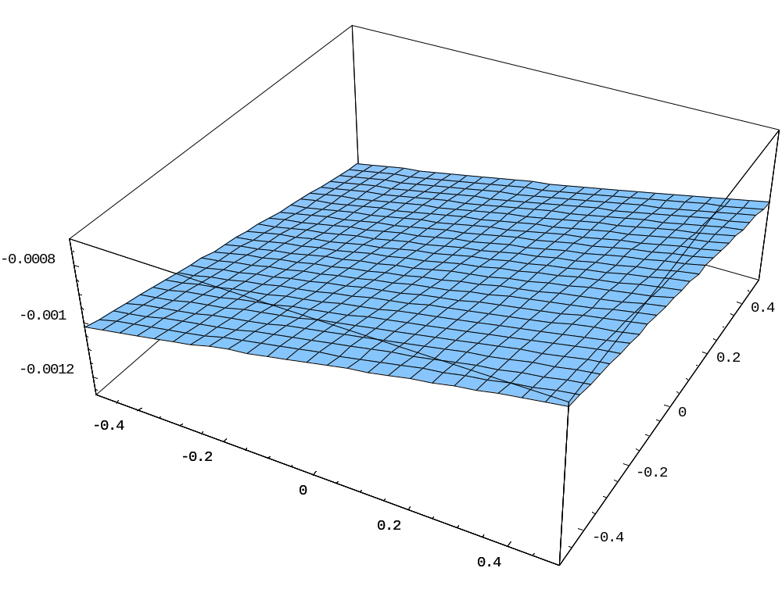
Calibration of the Cross Correlations
Only the difference between the cross correlations matters
Spreaoption(ATM-10bp)- Spreaoption(ATM+10bp)
Cross correlation U2-V1
Cross correlation U1-V2

Slide 15
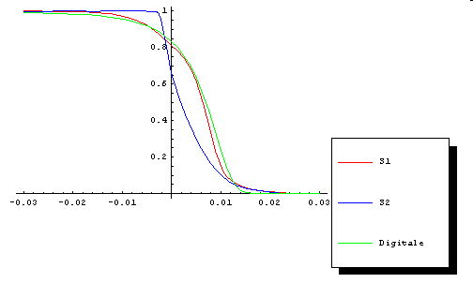
Closed Forms For Float Paying Digitals
Digital that Pays 1 , S1 or S2 if S1-S2>K
  Non gaussian distribution

